Slide 1
IOT based river water quality monitoring system using IBM cloud
-Team Nemo
M. Vinay
D. Kiran
T. Dileep

Slide 2
Contents:
objective
Block diagram
Technical requirements
design description
Flow description
conclusion

Slide 3
Objective
Water quality degradation has been a grave problem that has been left untackled by the human society. Water covers 70% of the earths surface and 40% of it is already deemed as polluted.
Water pollution at any location cannot be dealt with the same solution so This project aims at providing an insight at the quality of water in a region thereby enabling a quicker and accurate solution. Integrated with IOT and IBM cloud services this could prove a simpler solution than most existing ones.

Slide 4
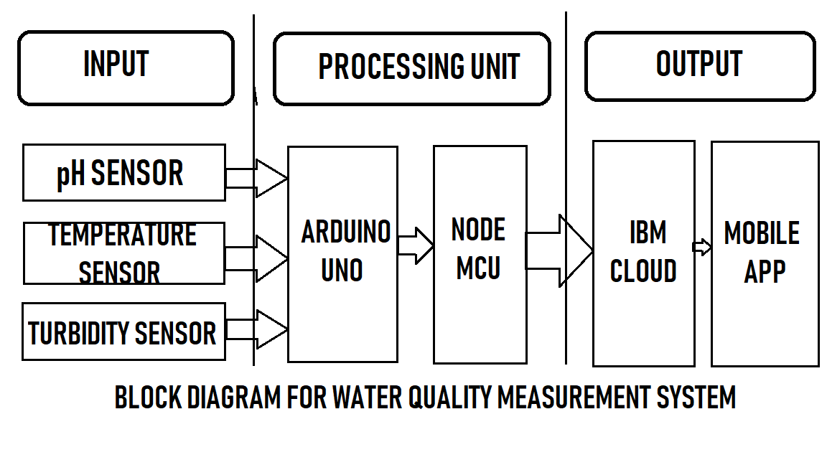

Slide 5
Technical requirements:
NODE MCU
Arduino Uno
Turbidity sensor
pH sensor
Temperature sensor
Arduino software
Node red
IBM cloud services
Mit app inventor

Slide 6
DESIGN description

Slide 7
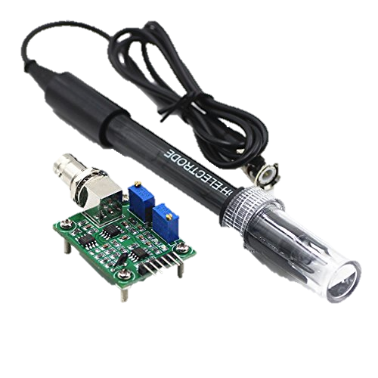
pH sensor
The ph sensor used in this experiment is a combination ph sensor i.e. it IS A type of electrochemical pH sensor that features both a measuring electrode and a reference electrode. The measuring electrode detects changes in the pH value while the reference provides a stable signal for comparison.
pH Reading: 0 to 14
mV Reading: -1250mV to 1250mV
Solution Temperature: 0 to 100C
Ambient Temperature: -40 to 70C (0C to 70C at rated accuracy)

Slide 8
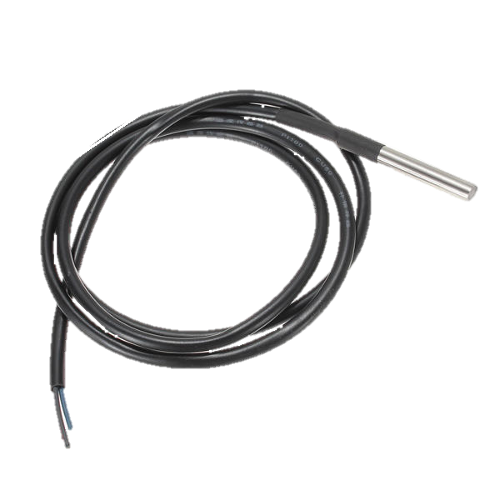
temperature SENSOR
Temperature is a crucial factor for determining the quality of water. The sensor used in this equipment is a ds18b20 model temperature sensor. This is a waterproof sensor that is cased in a stainless STEEL AND HAS OPEN END PROBES FOR EASY CONNECTIVITY.
Usable temperature range: -55 to 125°C (-67°F to +257°F)
Uses 1-Wire interface- requires only one digital pin for communication
Works with 3.3v as well as with 5v supply.

Slide 9
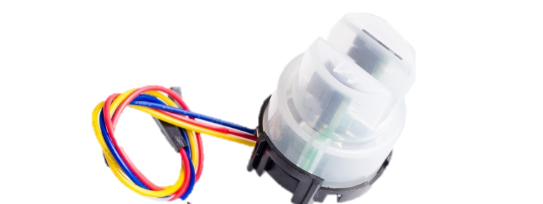
TURBIDITY SENSOR:
The Arduino turbidity sensor detects water quality by measuring level of turbidity. It is able to detect suspended particles in water by measuring the light transmittance and scattering rate which changes with the amount of total suspended solids (TSS) in water. As the TTS increases, the liquid turbidity level increases.
Operating Voltage: 5V DC
Operating Current: 40mA (MAX)
Response Time : <500ms
Insulation Resistance: 100M (Min)

Slide 10
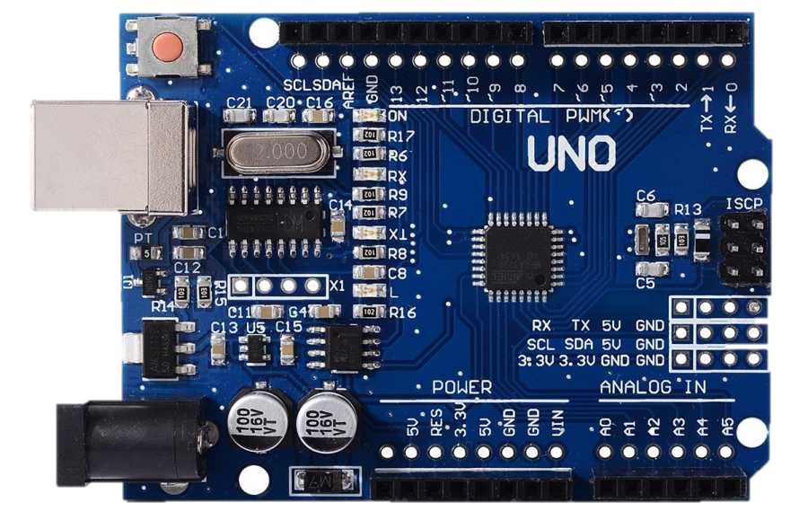
Arduino Uno:
The Arduino UNO is one of the many available open source microcontroller based on the AT328 microcontroller. It uses the Arduino IDE to interface with the computer wherein the user can code it to work as required.
In this project it is the central platform
That is connected to all the 3 sensors
(turbidity, temperature and ph). This is Also
Connected to the node mcu for Wi-Fi.

Slide 11
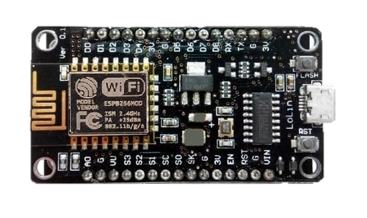
Node mcu:
Node MCU is an open-source firmware and development kit that helps you to prototype or build IoT product. It includes firmware which runs on the ESP8266 Wi-Fi SoC from Espressif Systems, and hardware which is based on the ESP-12 module. The firmware uses the Lua scripting language.
In this project NODE MCU has been basically used as a wifi module for the Arduino uno board.
Wi-Fi module esp12e
Micro usb for power and data transfer
5v power supply

Slide 12
Arduino ide:
The Arduino integrated development environment (IDE) is a cross-platform application (for Windows, mac OS, Linux) that is written in the programming language Java. It is used to write and upload programs to Arduino compatible boards, but also, with the help of 3rd party cores, other vendor development boards.
In this project this ide is used for giving the input program of the 3 sensors to the Arduino uno board.

Slide 13
Node red
Node-RED is a flow-based development tool for visual programming developed originally by IBM for wiring together hardware devices, APIs and online services as part of the Internet of Things. Node-RED provides a web browser-based flow editor, which can be used to create JavaScript functions.
In this project node red has been used to create a flow structure for the entire circuit and the output has been monitored in the cloud as well as on a mobile app.

Slide 14
IBM cloud services:
IBM Cloud is a suite of cloud computing services from IBM that offers both platform as a service (PaaS) and infrastructure as a service (IaaS).
Ibm Watson is a question-answering computer system capable of answering questions posed in natural language, developed in IBM's DeepQA project.
In this project we have used ibm cloud services as a database for the outputs we obtain from the setup and Watson has been used as the processor for the simulation created.

Slide 15
Mit app inventor
App Inventor for Android is an open-source web application originally provided by Google, and now maintained by the Massachusetts Institute of Technology (MIT), which allows newcomers to computer programming to create software applications for the Android operating system (OS).
In this project we have used MIT app inventor to develop a basic app that is cloud connected. It retrieves and displays data from the cloud. This app displays the temperature, turbidity and ph values determined the respective sensors.

Slide 16
Flow design

Slide 17
Sensors Measure data
Data
Transfer to Arduino
Arduino to ESP8266
Esp8266 to IBM cloud
IBM cloud to Mobile app

Slide 18
GITHUB LINK:
https://github.com/madman98/water-quality-measurement-project

Slide 19
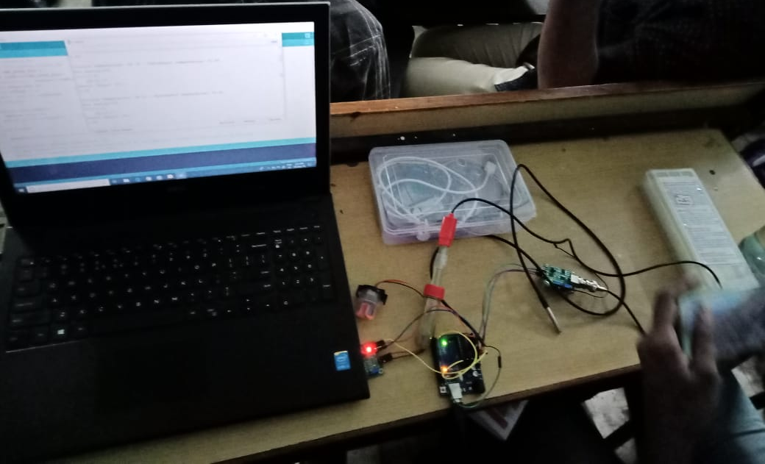

Slide 20
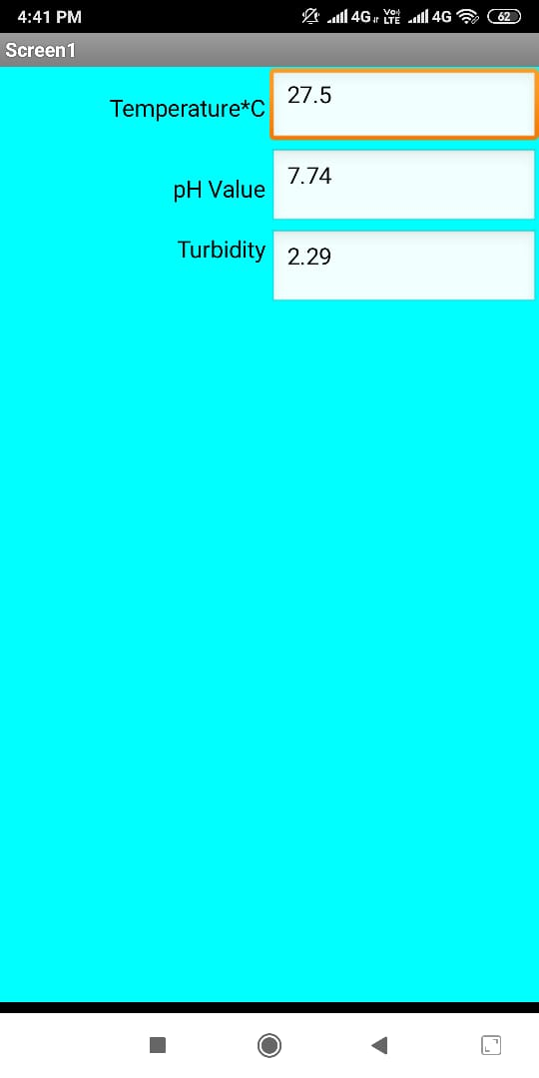
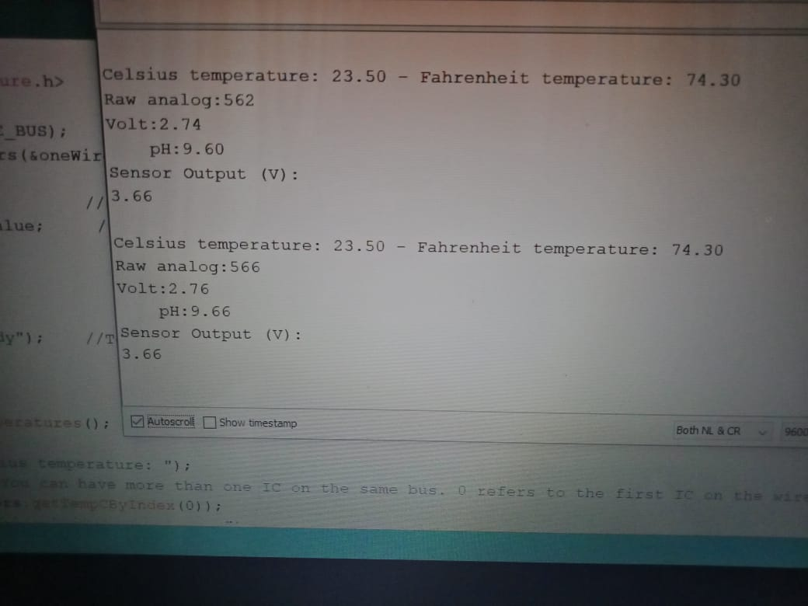

Slide 21
conclusion
The project here is a viable and simple solution to test water quality at any place. Since this equipment is connected to cloud storage the data can be easily accessed anywhere. The apparatus has been tested and has been proven to be quite successful.

Slide 22
THANK YOU

